Slide 1
Hulu's Content Trends
Insights for Content Creators
Presented by: Thant Thiri M. Kyi
Dec 2023

Slide 2
Brief Overview
Objective: To provide insights into Hulu's content trends which mean for content creators and producers.
Data: The dataset from Hulu provides details on various show attributes such as genre, duration, and production companies in 2017. It contains information about 1000 entries . Each entry represents a show or film and includes various details such as genre, ratings, episode count, and more. Key columns in the dataset include:
show/id: Unique identifier for each show.
show/name: Name of the show.
show/genre: Primary genre of the show.
show/genres: List of genres associated with the show.
show/is_movie: Indicator if the entry is a movie.
show/rating: Rating of the show.
show/seasons_count: Number of seasons for the show.
show/company/name: Name of the producing company.
Content creators and producers can rely this data to identify popular genres or themes that are currently in demand among Hulu's user base. It can help them make informed decisions about what type of content to produce or pitch to the platform.
Data-Source: https://www.kaggle.com/datasets/thedevastator/hulu-popular-shows-dataset Data-Source Credit-To:https://data.world/chasewillden

Slide 3
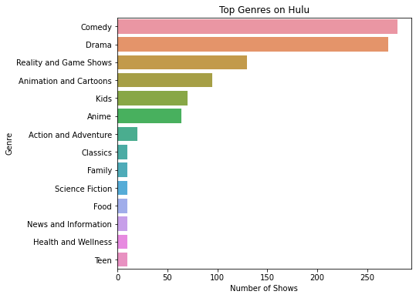
Hulu's Diverse Genres Landscape
Hulu caters to a wide range of tastes, emphasizing the most popular genres.
Comedy and Drama are the most represented genres in the dataset, followed by Reality and Game Shows, and Animation and Cartoons.
Other genres such as Action and Adventure, Classics, Family, and Science Fiction have fewer shows or movies.

Slide 4
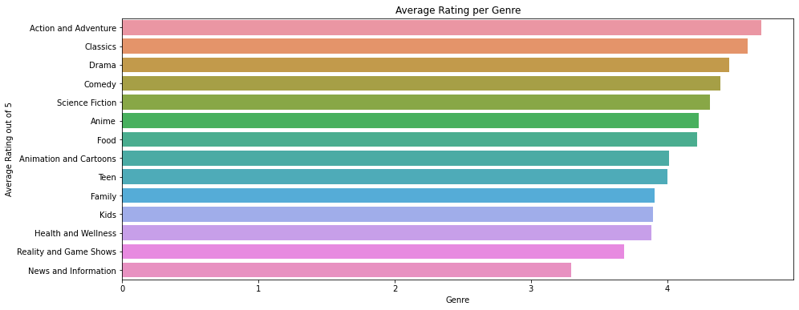
Popularity Analysis by rating
Although Hulu broadcasts the most comedy shows, Action and Adventure shows have the highest average rating, closely followed by Classics and Drama.
However, Comedy also holds a strong position in terms of average ratings.
Comedy and Drama genres not only have a high volume of content but also enjoy good ratings. This suggests a strong viewer preference for these genres.

Slide 5
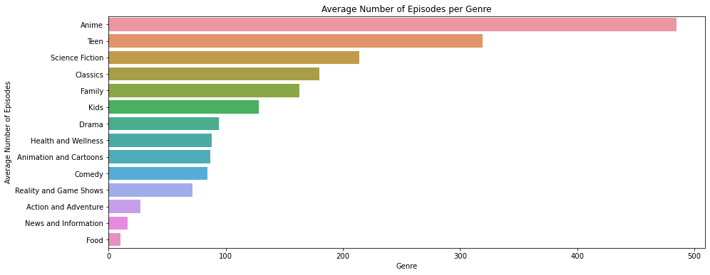
The length of Engagement
The Anime genre leads with the highest average number of episodes, followed by Teen and Science Fiction.
Longer Series in Certain Genres: Genres such as Anime and Teen have longer series on average, which could indicate a dedicated audience that engages with content over an extended period.
Impact on Viewer Engagement: Longer series can lead to deeper viewer engagement, as audiences invest more time in storylines and character development.

Slide 6
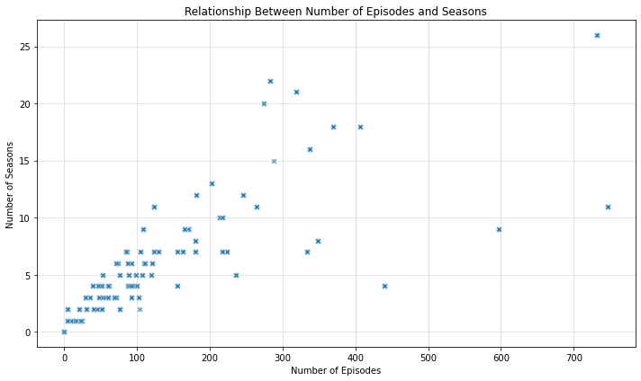
Content Promotion Strategy
The scatter plot presents a general trend where shows with more seasons tend to have a higher total number of episodes.
Longer Series with More Seasons: Shows that run for many seasons generally have a higher episode count. This can be an indicator of successful series that have been renewed multiple times.

Slide 7
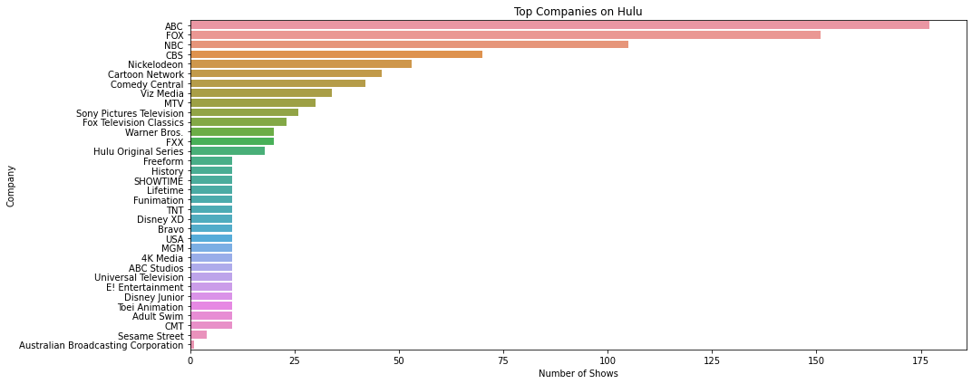
The Role of Production Companies
The top production companies include ABC, FOX, NBC, CBS, and Nickelodeon, with ABC leading in terms of the number of shows and movies provided.
Influence in Content Strategy: The top production companies play a significant role in Hulu's content strategy. Their shows and movies form a major part of Hulu's library, potentially influencing viewer preferences and expectations.

Slide 8
Key-takeaway
Understanding Audience Preferences: Continuous monitoring of genre popularity and ratings can help in quickly adapting to changing viewer preferences.
Dominant Genres: Comedy and Drama are the most popular, with high volumes and ratings, suggesting strong viewer preference.
Niche Genres with Potential: Genres like Action and Adventure, though less prevalent, show high engagement levels, indicating potential for growth.
Engagement Length: Anime and Teen genres exhibit longer series, suggesting a dedicated audience for long-term storytelling.
Content Promotion: There's a positive correlation between the number of seasons and episodes, indicating the success and longevity of series.
Role of Production Companies: Top companies like ABC, FOX, and NBC play a significant role in Hulu’s content strategy, offering opportunities for strategic partnerships.

